Slide 1


Slide 2


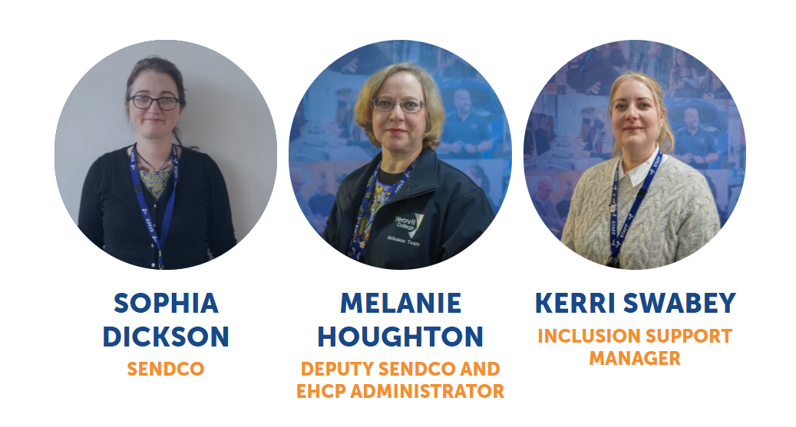
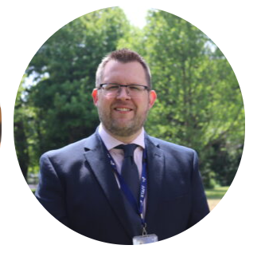
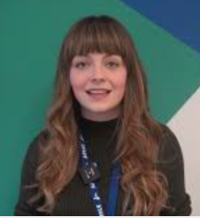
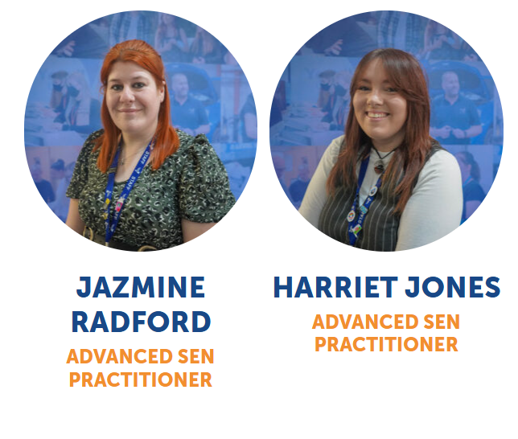
SENDCo For ALL: All curriculum areas and provision types. All areas include High needs (EHCP)
All CAM areas INC. FL and PP
All Provision Types:
Apprentices and Adults Provision Type
16 -18 Provision Type:
AP Curriculum
SENDCO
AP Apprentices/EE
SENDCO
Head of Adults & HE
Inclusion Support Manager
SENDCO
AP Curriculum
KSP
KP
SALT - JL
Exam (EAA) & Consults Guru
Assessment/ reports & training
Exam (EAA)
Assessor
Any learner: (EAAs)
Advanced SEND Practitioners
Coordinating ALS/SEND provision. Liaising with learners, Inclusion Support Manager, CAMs, Assessors, Employers and SEND Practitioners
Deputy SENDCo
Chairing/Coordinating all Annual Reviews. Liaising with learners, CAMs, SPMs/Lecturers and SEND Practitioners. Prioritising SALT Caseload with her.
Coordinating EAAs. Liaising with same as (& with) Deputy SENDCO – Also Exams
SEND Practitioners:- advocating for learners and working closely with CAMS, SPMs and Lecturers to support learners. This can be on Teams, in class or 1:1 sessions. This is for learners with EHCPs and SEND (no EHCP); for 16-18, adults or apprentices. CAM Areas:
CAM Area
Interventions. Support: LSPs
Foundation Learning & Progression Pathways
CDI
Motor
Vehicle
A Levels
and Business
Hair Beauty and Hospitality
Sport/UPS
Health and Social Care Childcare
Construction
Engineering
IT

Slide 3


SEND Team (Assess – Plan – DO – Review): from application onwards​
Updating SEND policies
Applications
Consults and EHCPs
IMVs with TALQ Team. Being on internal key groups (representing SEND for all).​
​
​
Training for all staff.
SEND and Partnership Links
Liaising with schools and Local Authority
Going to School Reviews
Attending & supporting FTS & Disciplinaries, advising steps/ support and updating support information on their One Page Learner Profiles.
Holding and attending annual reviews.
Developing and reviewing plans, outcomes, strengths & needs, provision/ support and resources.
Transition panels with Learner support services and summer work with Gayle’s Team.
Working internally with curriculum staff.

Slide 4
Frequently Asked Questions
My young person has an EHCP, does this continue to college, and will they get annual reviews?
My young person has an EHCP, does this mean they will go into the Foundation Learning?
My young person does not have an EHCP, but they do have SEND need, how will they be supported at college?
My young person has an EHCP and has applied to Yeovil College, will they automatically get a space?
My young person is coming to college without an EHCP, but needs one. What do I do?
My young person is really able, but has and EHCP/SEND needs, how will they be supported?
Notes:
​

Slide 5
Application Process
The SEND Team work closely with schools in particular with their SEND department once a learner has made an application or has been identified through a transition panel.
Apply
CAM Areas:
Across College
CAM Area:
Foundation Learning
Progression Pathways
EHCP and SEND learner meets Curriculum Team and SEND Team face to face.
EHCP – Meet SEND Team before offer
SEND – Meet SEND after offer
The SEND team are on hand to support with additional transition work (if required) and will work alongside students and their families throughout a student’s time here.

Slide 6
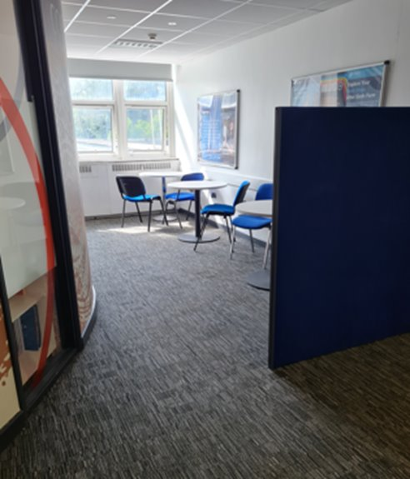
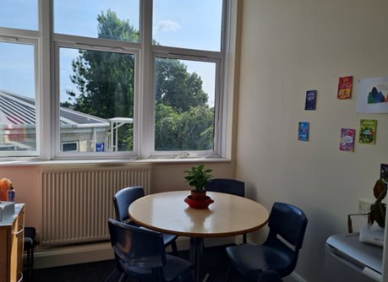
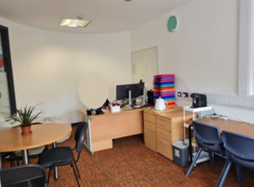
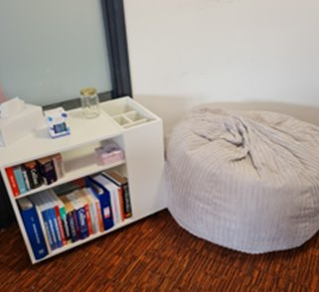
Our Spaces
Inclusion quiet area available at break and lunch.
Dedicated SEND office space that learners can access.
Private 1 to 1 intervention rooms.

Slide 7

The Thrive Approach
SEMH as a need for SEND, EHCP (High Needs) and all learners is increasing year by year.​
​
We are still seeing the still unknown effects of Covid on our younger generations. ​
​
At Yeovil College, we recognise this, and we have two Thrive Practitioners already, with four more in training currently. There will then be practitioners in the SEND Practitioner Team, in Foundation Learning/ Progression Pathways and there is already a Thrive trained member of staff in the Support Team.

Slide 8
Our Learners
“The Deputy SENDCo and Head of Foundation Learning worked together to help me arrange and do work experience in Preparation for Life and Living, which I really enjoy.”
“The Deputy SENDCo at Yeovil College helped and suggested Health and Social Care. I am now doing a course I enjoy and that I think will help me get to where I want to in the future.”
“The SEND Quite Area/Inclusion Area helps me have a place to go to at lunch, breaks and other times.”
“My Lecturer helps me tremendously: not only with education, but with my processing and explaining why something is happening, including my views, and listening to the people that support me from the SEND Team, to put in adaptations so I can engage for longer.”

Slide 9

Foundation Learning Pathways
There are several different pathways throughout our Foundation Learning department, each are designed for different needs and different outcomes.
Preparation for Adulthood
Preparation for Life and Living
Supported Internship
Progression Pathways – Personal Development or Sector Pathways
Pathway to Change
Every learner’s needs are looked at on an individual basis, so if you are unsure which course will be right for your young person, we recommend getting in touch with the team so we can support you.

Slide 10

Transition to Foundation Learning
Moving to college
We work closely with incoming students and school partners to ensure a smooth transition into Further Education. This could include; additional visits across a sustained period, curriculum exploration, opportunities to meet the team, library tours and visits to our canteen and café areas.
Buddy System
We operate a ‘buddy’ system for all new students. Enabling future students to connect with current students and form a bond with people who have been in the exact same position.
Early Integration
We thoroughly believe in transition and preparation for next steps, which results in early transition planning and visits.

Slide 11
Student Support Services at Yeovil College
We have a fantastic Student Support team here at Yeovil College, all our staff are trained and in place to support learners with any challenges they may face throughout their time with us.
Our team:
Safeguarding Officers
Pastoral Support Practitioners
Student Support Coordinator – supporting transitions and CLA learners
PSHE Tutor
Campus Support Responders (First Aid)
Associate Chaplain

Slide 12
What We Do
Support with external agencies for families e.g. Family Intervention and Children’s Social Care, CAMHS, Virtual School.
Deliver tutorials across college – with a focus on Personal, Social, Health and Economic Topics.
Create a vibrant student community where everyone has the opportunity to have their say and get involved through our Student Union, Student Ambassadors, and Student Voice programmes.
We have a dedicated Safeguarding team in place to offer advice, support or make referrals for additional services that may be able to offer specialist help.
We offer pastoral support to any learners requiring extra help to enable them to engage fully with their learning. This can be 1-1 support or in small groups for targeted support around bereavement, wellbeing, faith, LGBTQIA+ or Young Carers.
Work with our Student Assistance Programme to ensure that learners have 24/7 access to support and online counselling opportunities.
Sexual Health Service (SWISH) and Eating Disorder Support (SWEDA) accommodating fortnightly clinics at the college.

Slide 13
Child Looked After or Personal Education Plans
We are the main point of contact for any learner who is a Child Looked After (CLA) or has a Personal Education Plan (PEP).
We work closely with our SENDCo to ensure that any learners with an EHCP that may also be either a child looked after (CLA), on a child protection plan or child in need plan, have all the support in place that they need.
Any learners that are a CLA, will have a main link at the college. Our main link is Richard Watson, who will work with the learner and curriculum staff to ensure that PEPs are up to date and relevant to share with the Local Authority.

Slide 14
What to do if a learner needs support?
Before joining college
Prior to joining, we work closely with our school partners to ensure that any learners who will require support are identified, allowing us to plan the right resources and support for their September start. This may include Additional Transition Visits from Easter onwards and throughout the Summer Holidays.
At college
Once at college, learners can self-refer for pastoral support through a QR code, or via visiting the office and speaking with one of the team.
Additional Transition
We can support with additional transition packages between leaving school and joining college. This may include; visits from as Early as Easter and throughout the summer holidays to get used to the campus and new surroundings. They have the opportunity to meet and begin building a relationship with one of the pastoral team so that there is a key member of staff to support them from September onwards.
For more information on this please contact:
Tina Callow – Head of Student Support and Designated Safeguarding Lead – Tina.Callow@yeovil.ac.uk
Richard Watson – Student Support Coordinator & Designation CLA & PEP Link – Richard.Watson@yeovil.ac.uk

Slide 15


